Slide 1


Internet of Trash
Minor Innovation & Research

Slide 2

Agenda
I.o.Trash
The team
The problem
How did we proceed?
The solutions
Costs implementation
Future scenario
Conclusion

Slide 3
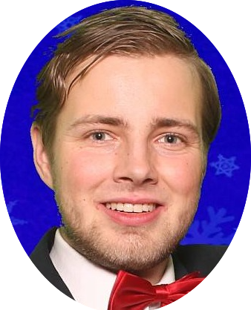




The team
I.o.Trash
Herm Lecluse
Herm.lecluse@gmail.com
Software engineering
Rick van Osch
rickjlvanosch@gmail.com
Software engineering
Loek Ehren
loek-ehren@hotmail.com
Software engineering
Mike Schatorjé
Mike.schatorje@hotmail.com
Business Informatics
Simone Francesconi
smn.francesconi@gmail.com
Business management

Slide 4
The Problem

Slide 5
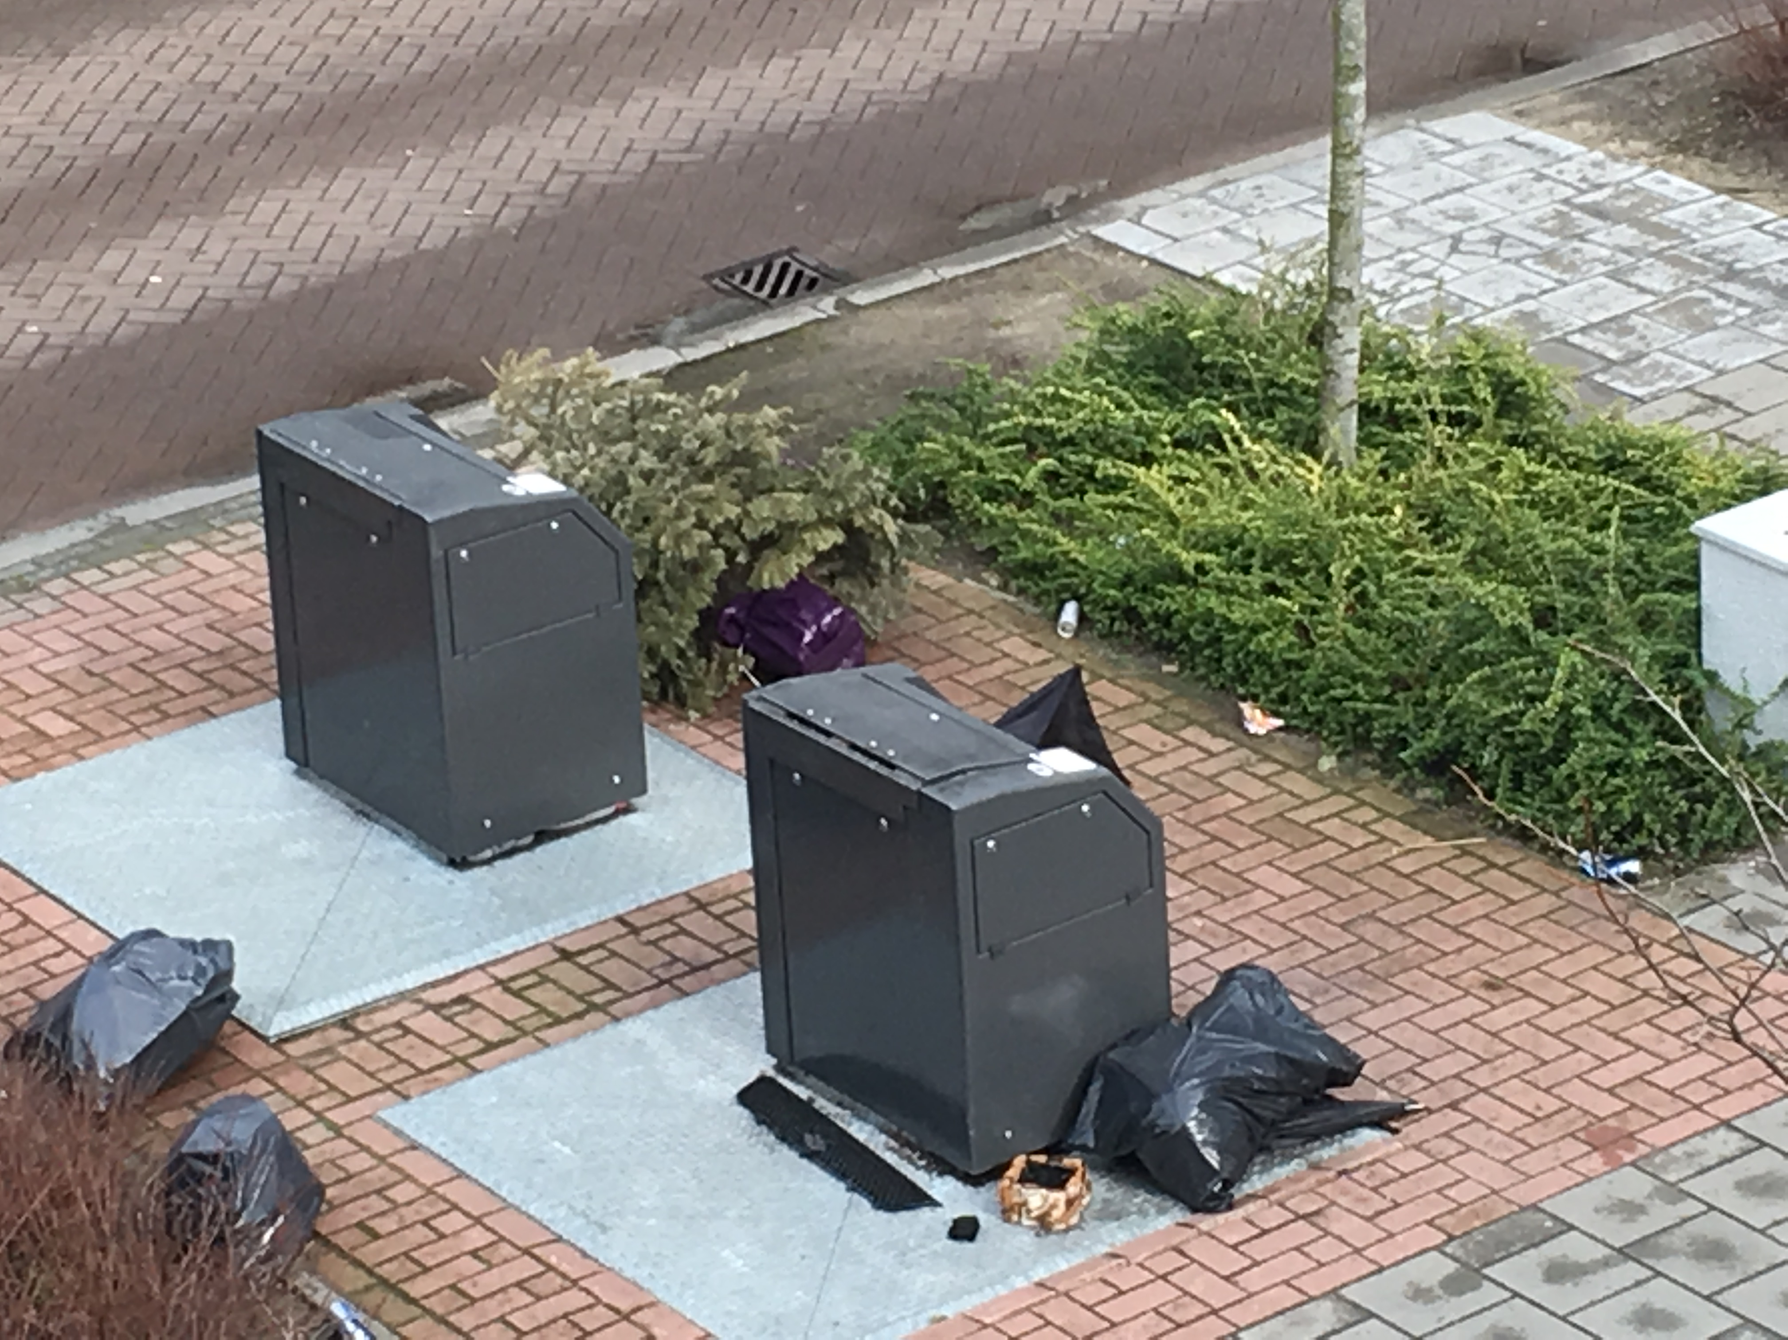
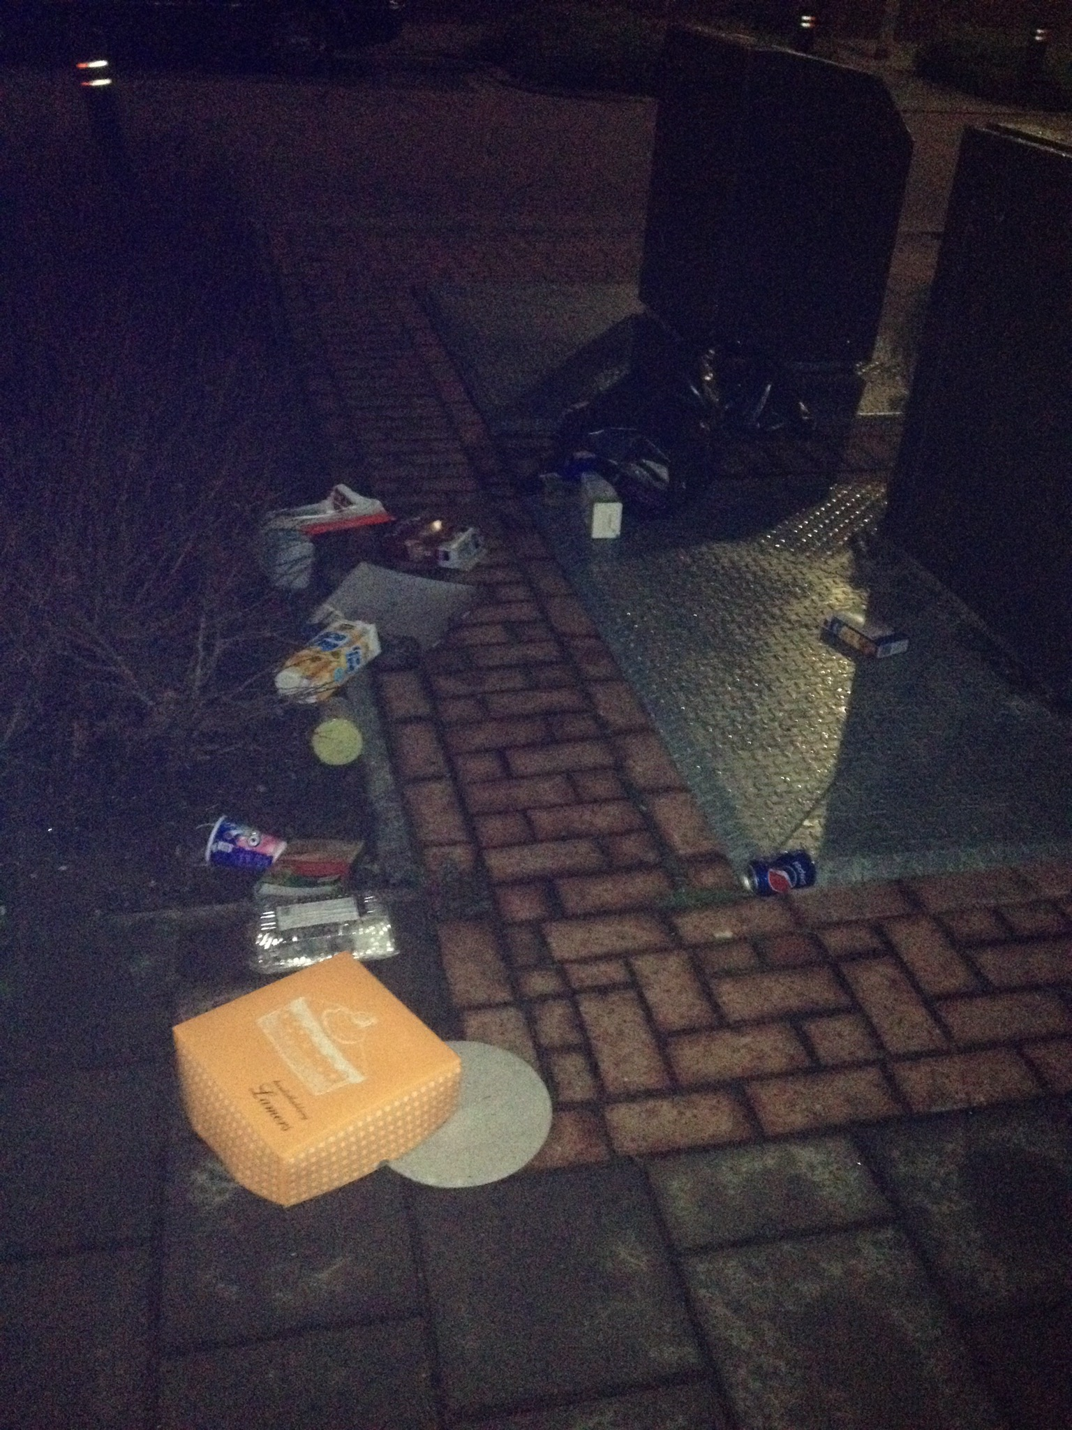
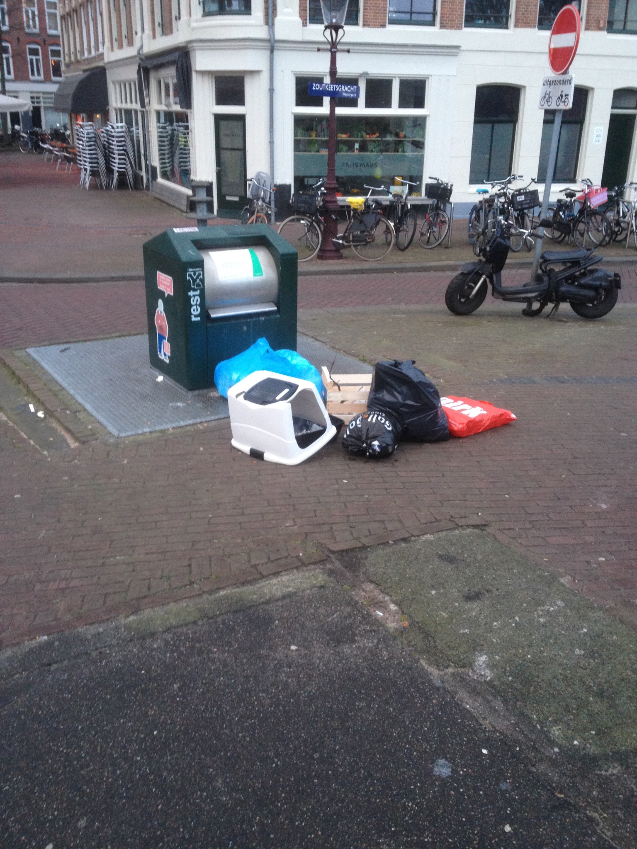
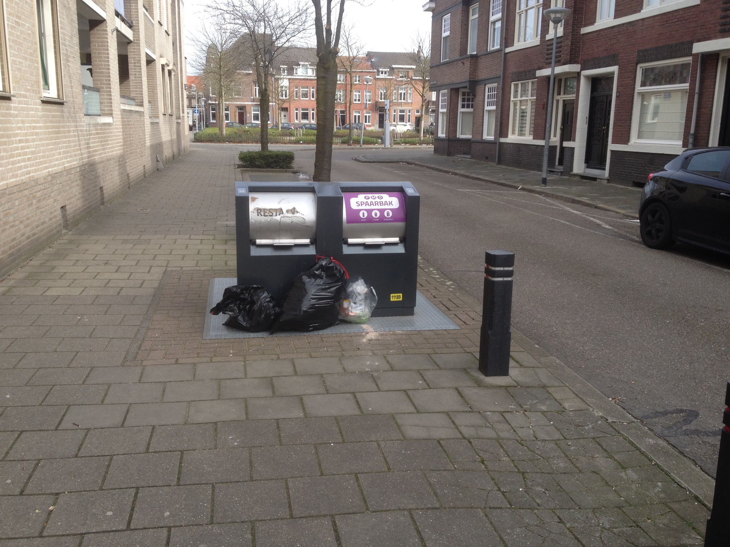
The problem
I.o.Trash
Dirty enviroment
Waste of energy
Waste of time
Citizens’ behavior

Slide 6
How did we proceed ?

Slide 7

Starting point
I.o.Trash
Work group – brainstorming
Research questions
How to improve the underground garbage collection system?
Which technologies do we need?
What does the current system consist of?

Slide 8
In between
I.o.Trash
Analyse the current situation
Familiarise with technologies
Interviews
Current process map
Map critical points detection
Testing
Design
Implementation
Efficiency
Organization
Technology

Slide 9
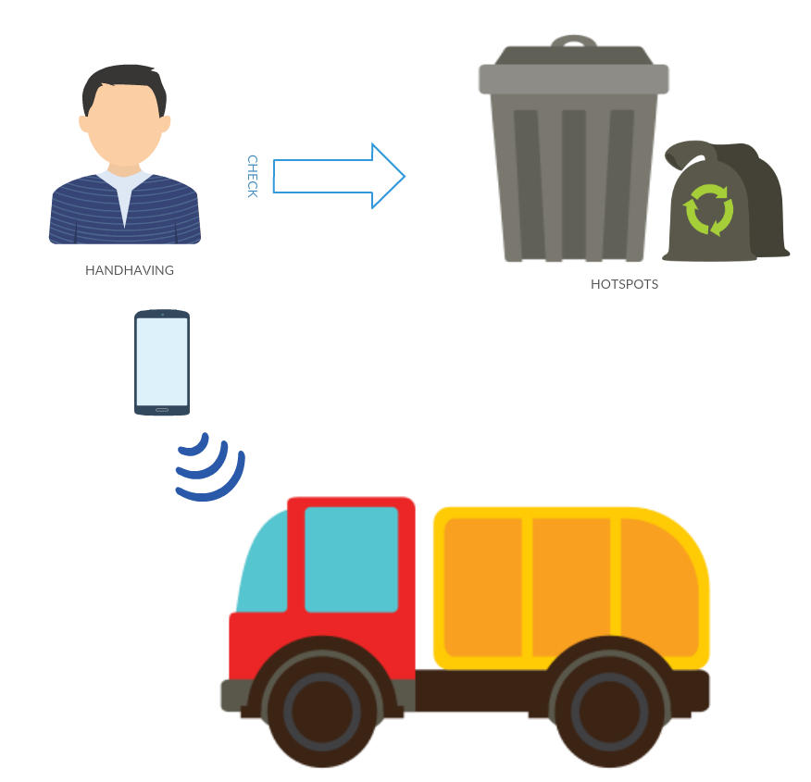
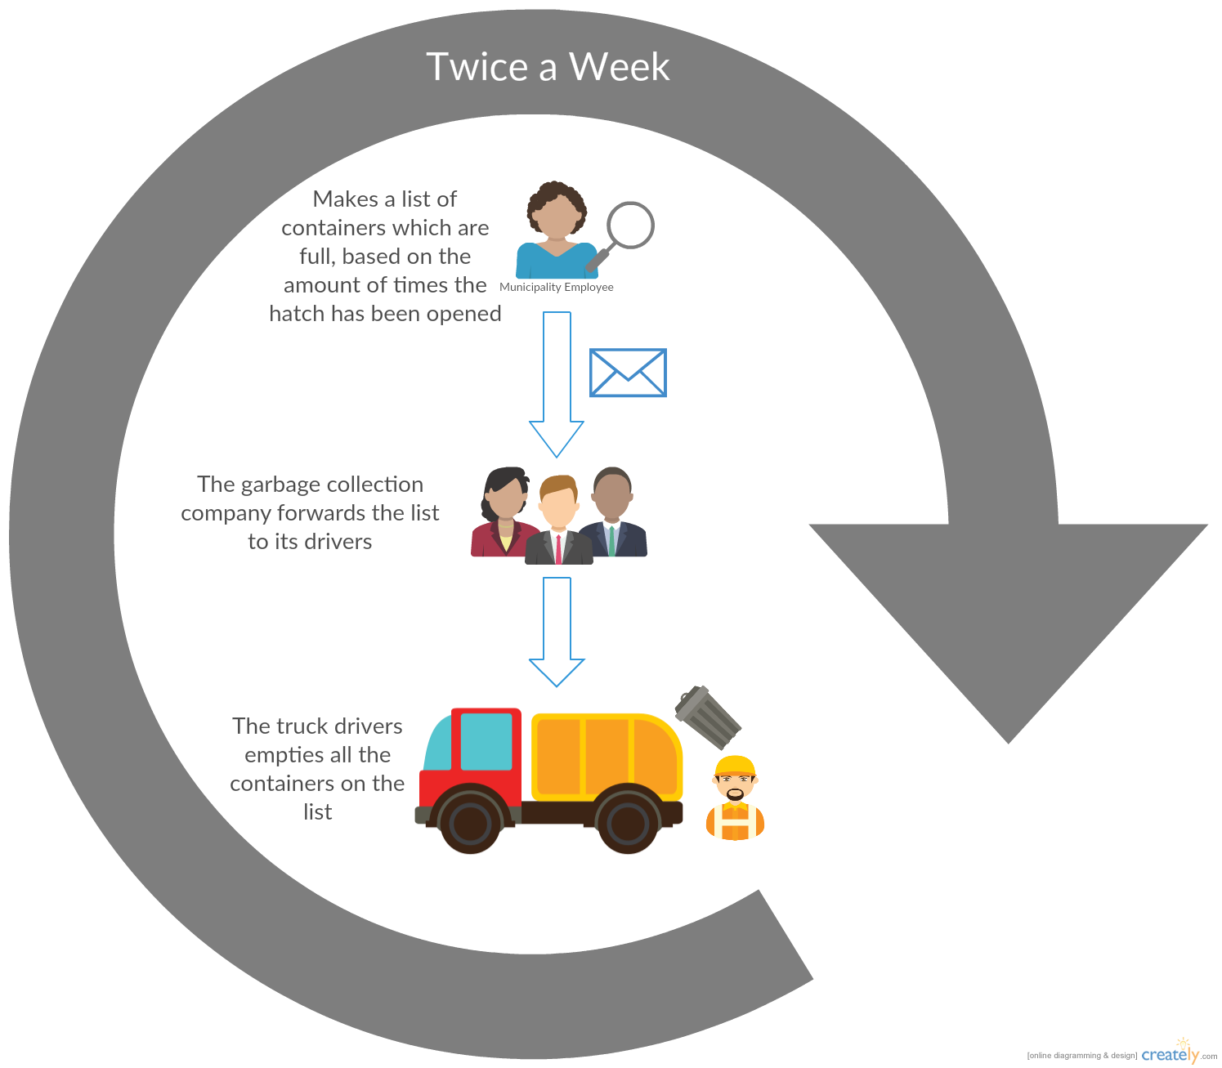
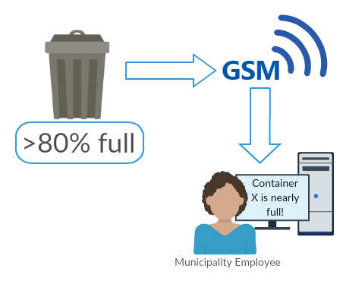
Results
I.o.Trash
Main process
Secondary process

Slide 10

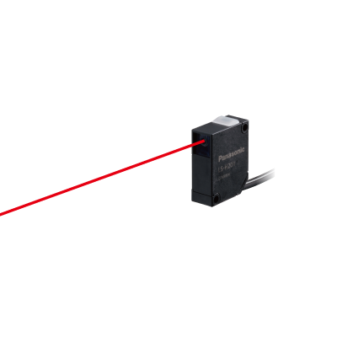

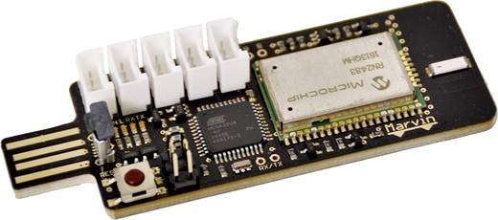
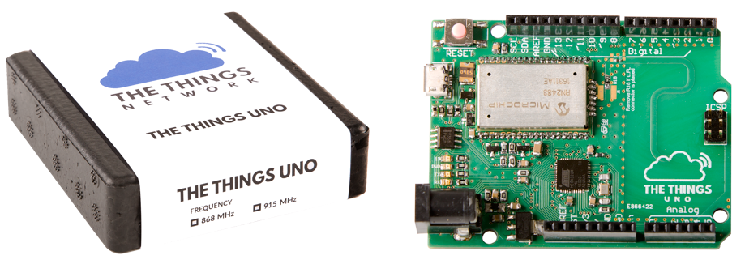
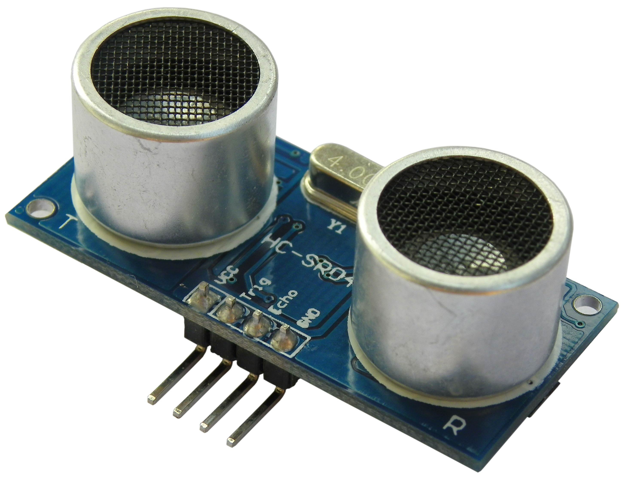

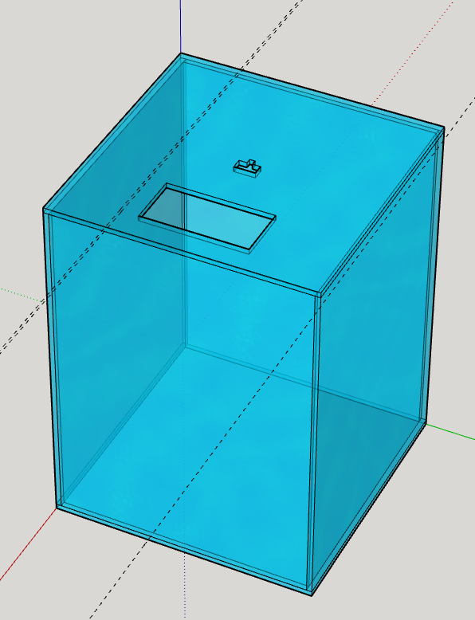
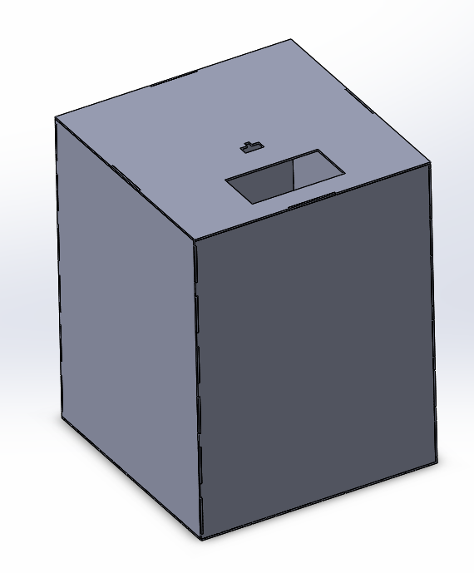
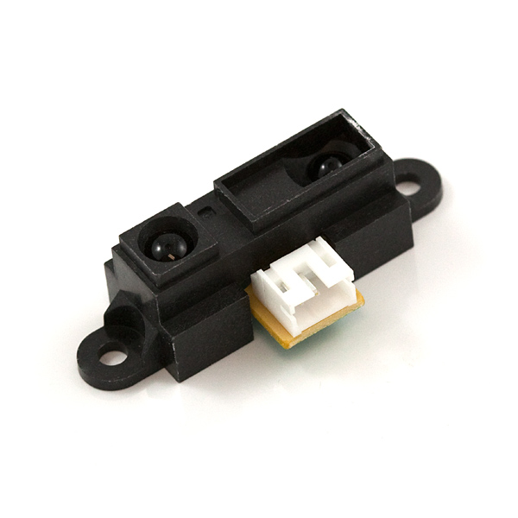
Results
I.o.Trash
Laser sensor
Ultra sound sensor
Infrared sensor

Slide 11
The solutions

Slide 12

Work combination
I.o.Trash
LoRaWAN system
Organizational & Technological changes
Optimize garbage collection
New tools in order to collect the underground garbage containers in the cheapest and fastest way possible
Change citizens in behavior
Long term effects derived by our system

Slide 13
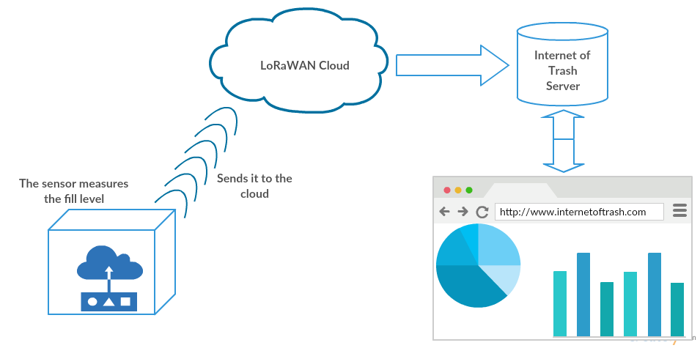
The new system
I.o.Trash

Slide 14
Changes in processes
I.o.Trash

Slide 15
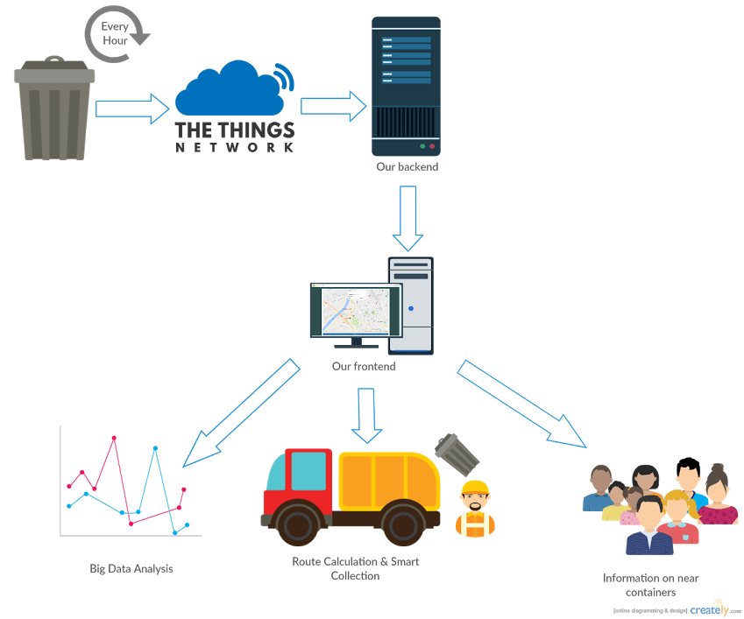
The new process
I.o.Trash

Slide 16
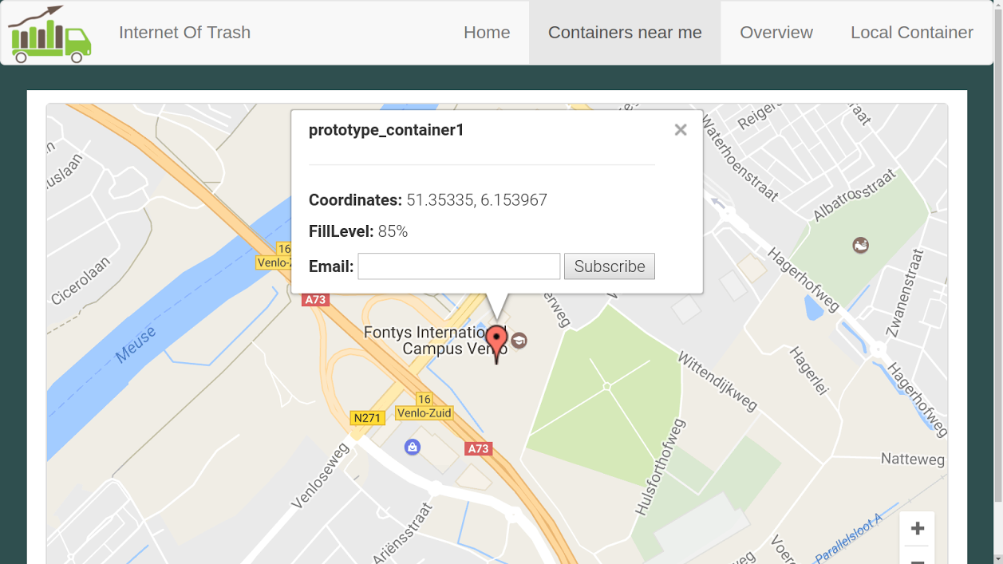
The Interface
I.o.Trash

Slide 17
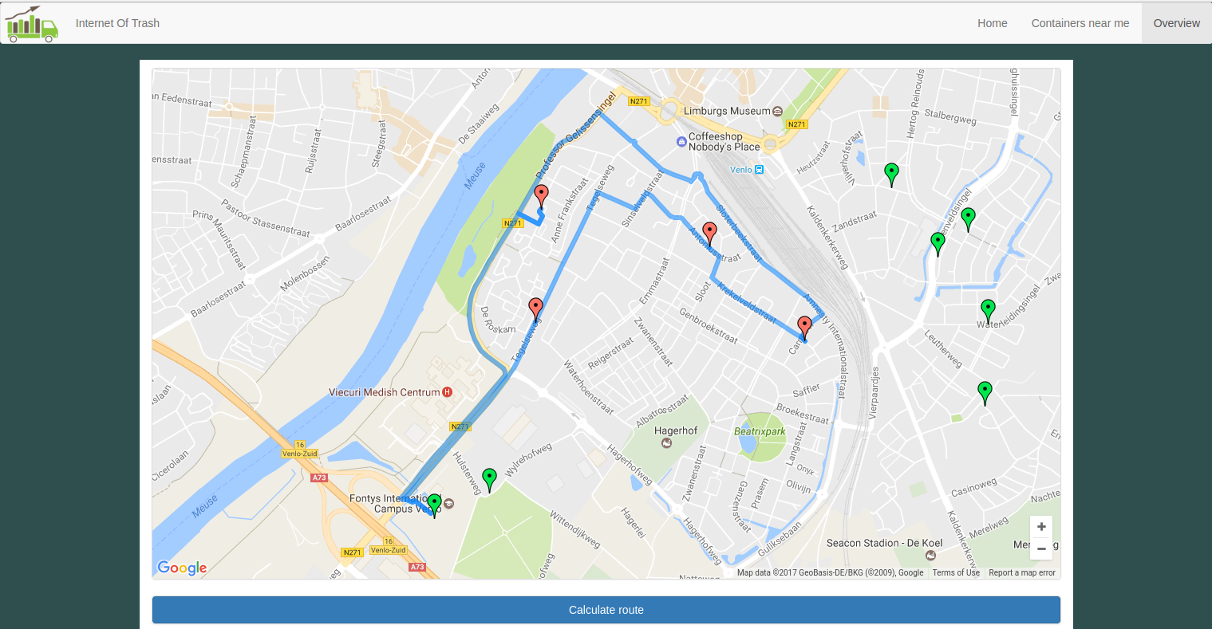
The route calculation
I.o.Trash

Slide 18
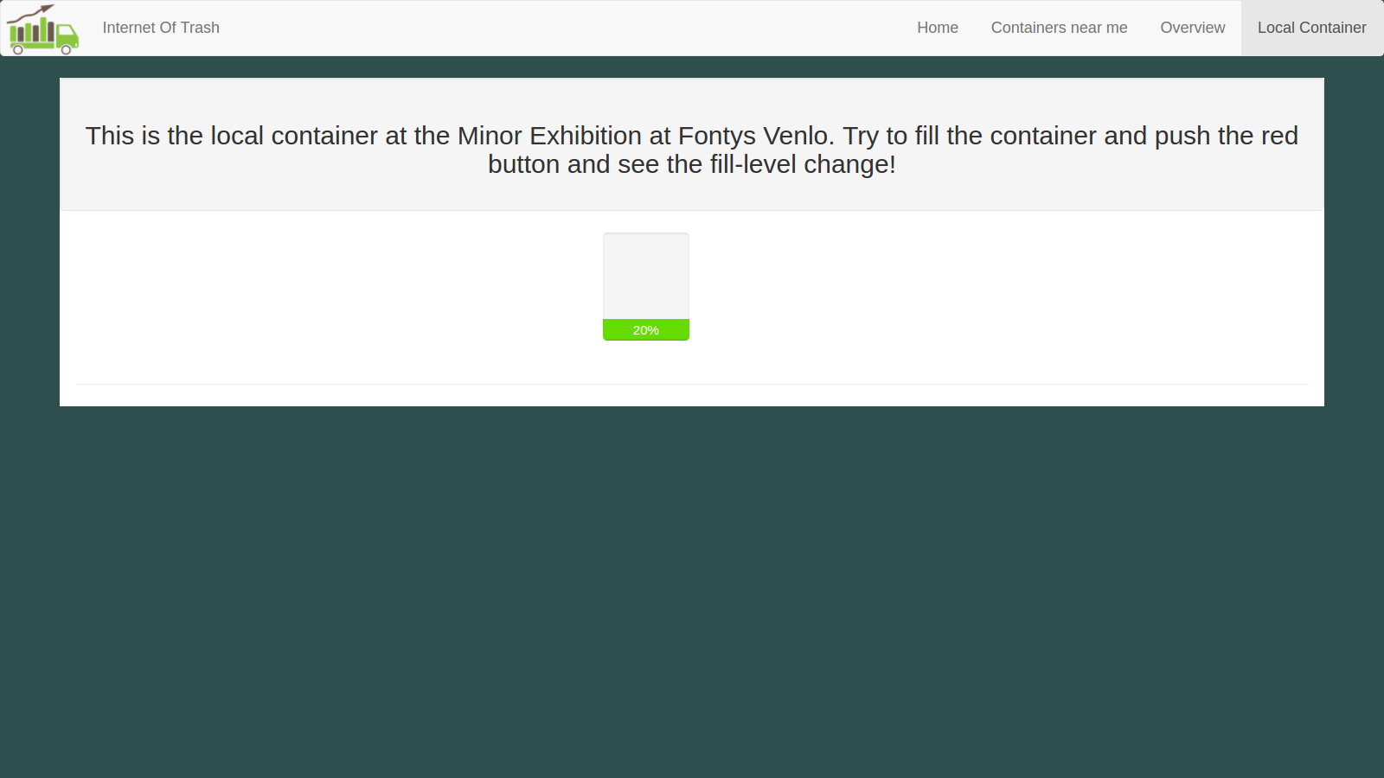
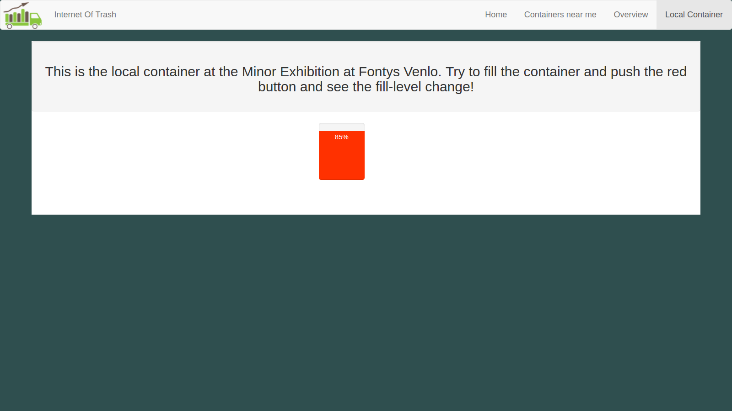
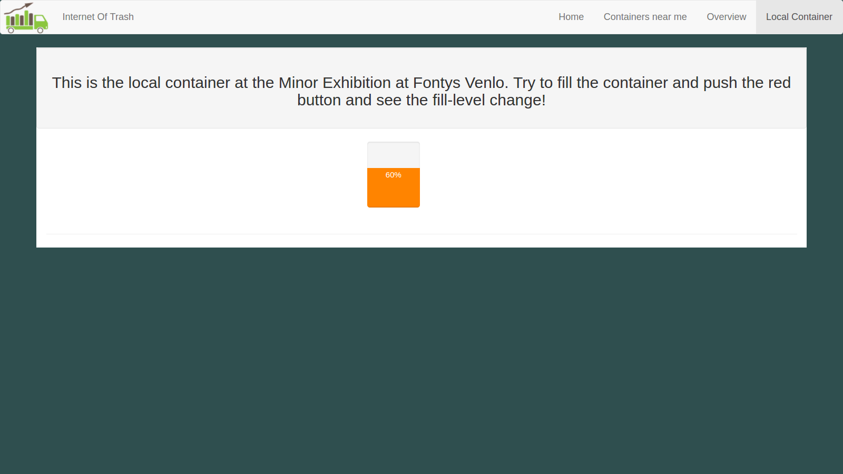
An example
I.o.Trash

Slide 19
Costs implementation

Slide 20
Investment
I.o.Trash

Slide 21
Costs analysis
I.o.Trash

Slide 22
Future scenario

Slide 23
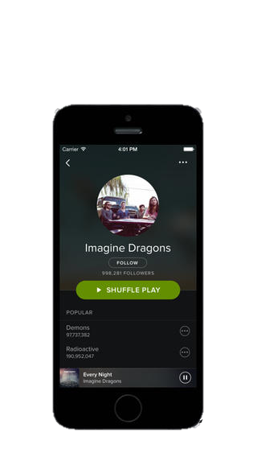
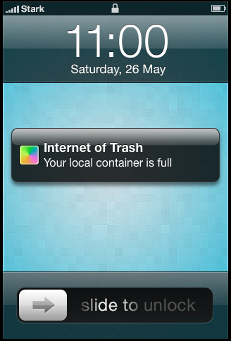
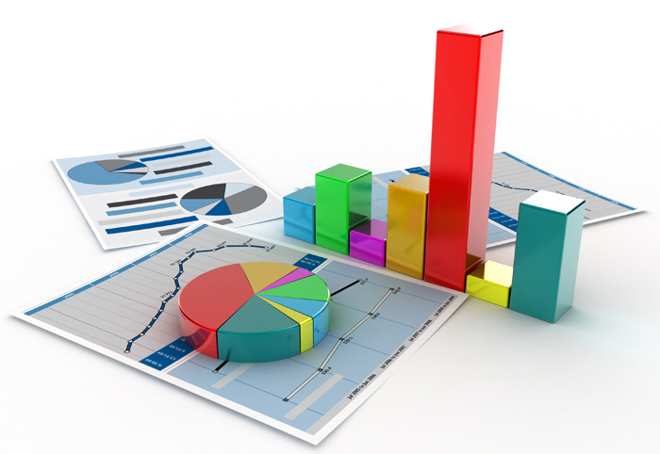
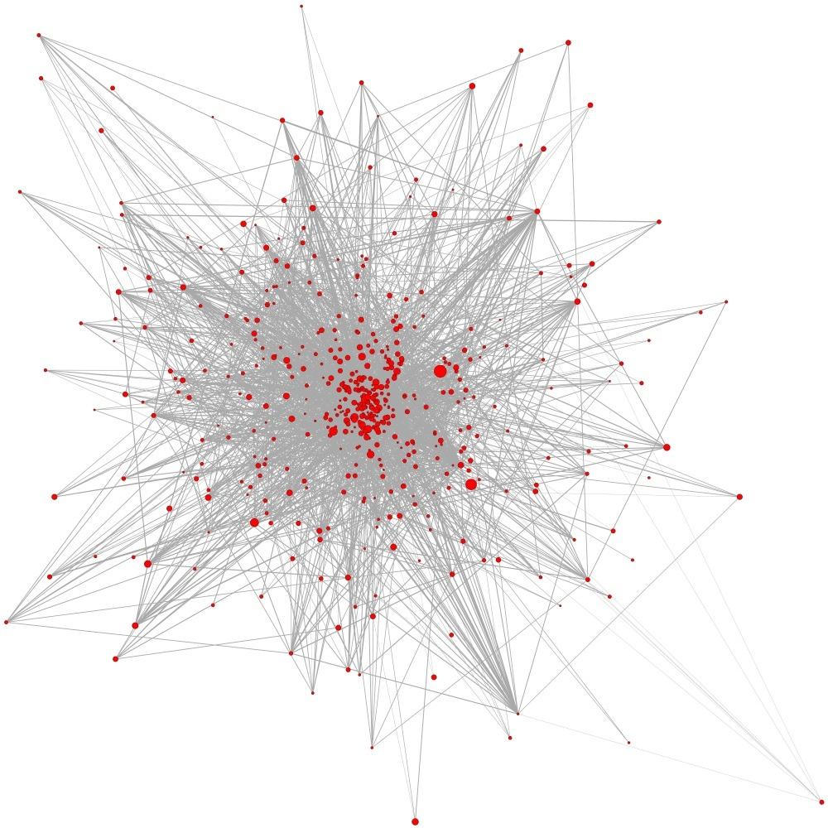
Future scenario
I.o.Trash
Mobile application
Connected with the citizens
Proactive notifications
Data analysis
Forecasting
Waste under control
Optimize collection
Algorithm
Save money

Slide 24
Conclusion

Slide 25
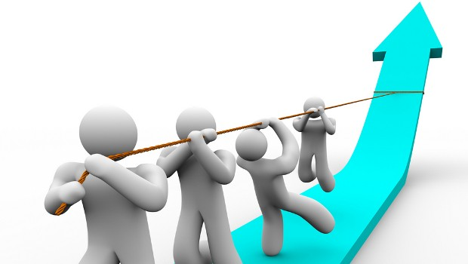
Conclusion
I.o.Trash
Reduce the amount of energy and money wasted
Higher efficiency
Cleaner environment
Citizens’ awareness

Slide 26
Thanks for your
attention
Any questions?
I.o.Trash
You can find us at:
smn.francesconi@gmail.com
herm.lecluse@gmail.com
rickjlvanosch@hotmail.com
mike.schatorje@hotmail.com
loek-ehren@hotmail.com

